Slide 1



Mechanical Engineering Master’s Thesis Defense
Candidate: Jakob Frabosilio
Committee: Dr. John Ridgely (chair)
Charlie Refvem
Dr. Siyuan Xing

Slide 2
Presentation Outline
Introduction
Ground-Truth Positioning System
Acoustic Positioning System
Absolute Orientation and Dead Reckoning
Kalman Filtering
Data Collection and Results
Conclusion and Future Work

Slide 3
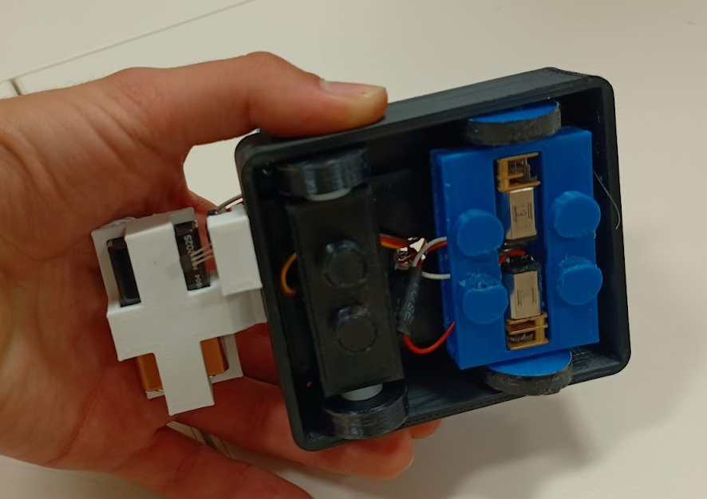
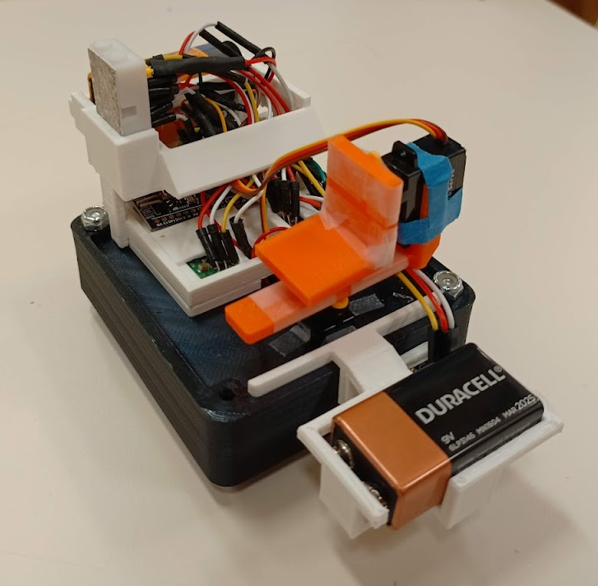
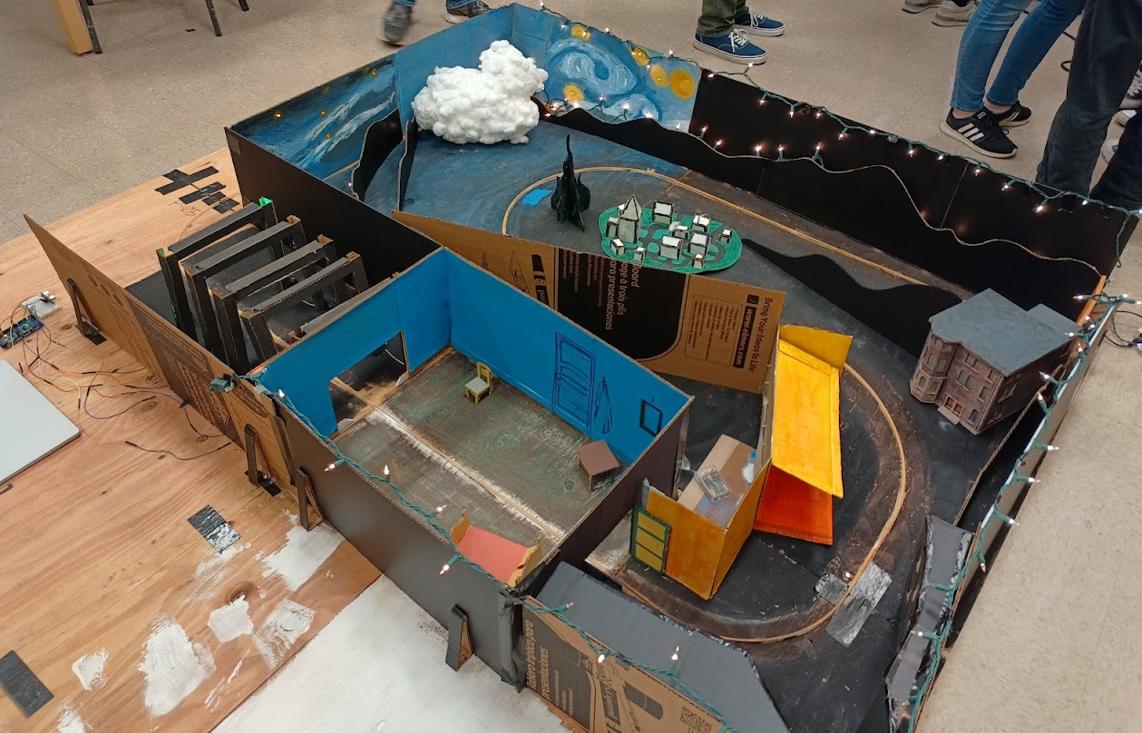
Self Introduction
Jakob Frabosilio
Started B.S.M.E. in 2018
Started M.S.M.E. in 2022
Member of Cal Poly Mustang Band for all six years of college
First mechatronics project in Sep 2019
Dark Ride: CAPED Project
Designed ride vehicle

Slide 4
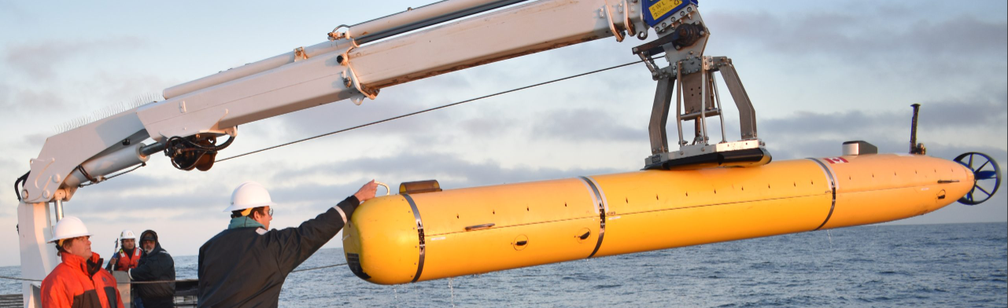
Problem Definition
Autonomous Underwater Vehicles (AUVs) are used to collect data in the ocean and require position information
Examples: shipwrecks, ocean floor mapping, phytoplankton level monitoring, search-and-rescue, and so much more
Problem: GPS does not work underwater!
Need a way to reliably determine AUV location when submerged for long periods of time

Slide 5
Existing Solutions
Solution | Benefits | Drawbacks
GPS/GNSS | Moderate accuracy (< 3m) Does not drift over time | Does not work underwater (surfacing required)
Dead Reckoning | High accuracy for small ΔT Local solution | Estimate drifts over time High sampling rate required
Simultaneous Localization and Mapping (SLAM) | Creates map of environment Local solution | High computational cost Requires precise SONAR
Acoustic Positioning | Sound travels far in water Does not drift over time | Requires line-of-sight Noise pollution concerns
Muometric Positioning | Works anywhere on Earth Very high accuracy (3.9cm) | Very recent research (2023) Not many implementations

Slide 6
My Approach
Combine acoustic positioning, dead reckoning, and GPS
Buoy on surface of water with GPS and acoustic transmitter
GPS provides absolute reference to global frame
AUV with microphone array and dead reckoning equipment
Acoustic positioning provides relative reference to GPS
Dead reckoning provides short-term relative position
Use sensor fusion to blend three methods
Test system above-water, extrapolate to underwater
Lower cost, no waterproofing req’d, lower speed of sound

Slide 7
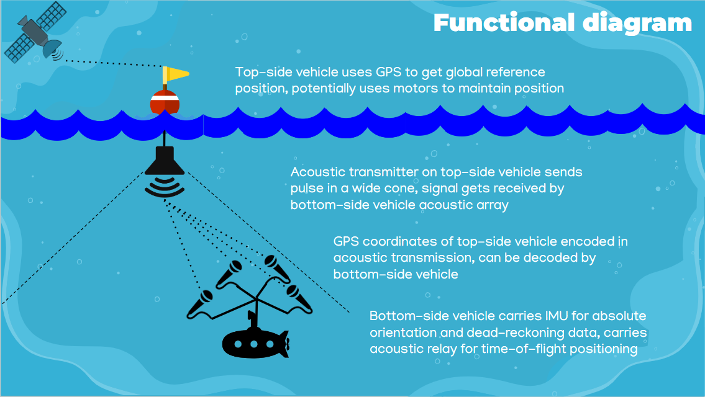
Functional Diagram

Slide 8
High-Level Overview
Use ground-truth positioning system to verify accuracy, simulate motion of AUV underwater
Transmitter sends out a pulse of ultrasonic sound
Four microphones on receiver array record the pulse
Time difference between microphone signals is calculated
Position of transmitter estimated using time differences
Array orientation and dead reckoning estimated using IMU
Fuse estimates with a Kalman filter
Position estimate of array is compared to ground-truth

Slide 9
Ground-Truth Positioning System

Slide 10
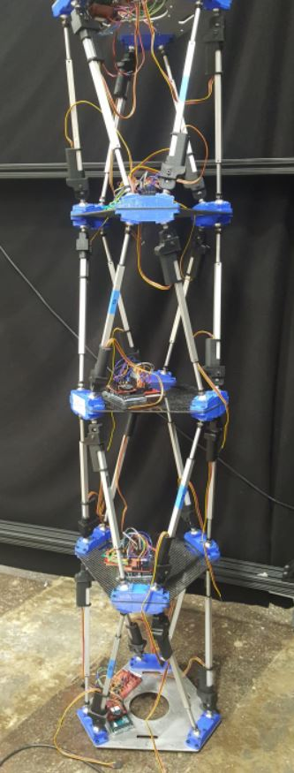
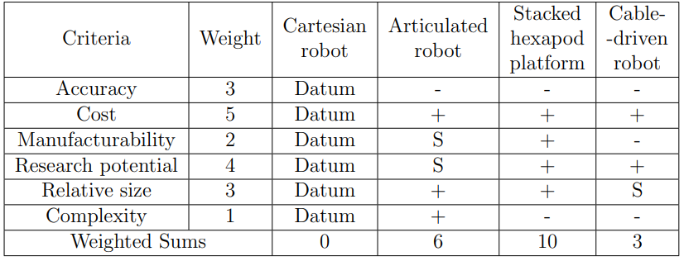
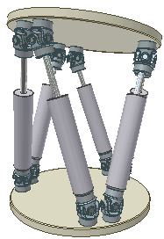
Design Inspiration
Need a 6-degree-of-freedom (6-DOF) actuator
Low cost, high research potential, high accuracy
Stewart platform (“hexapod”) is 6DOF
NASA research, stack hexapods to increase range
Use in spacecraft equipment manipulation

Slide 11
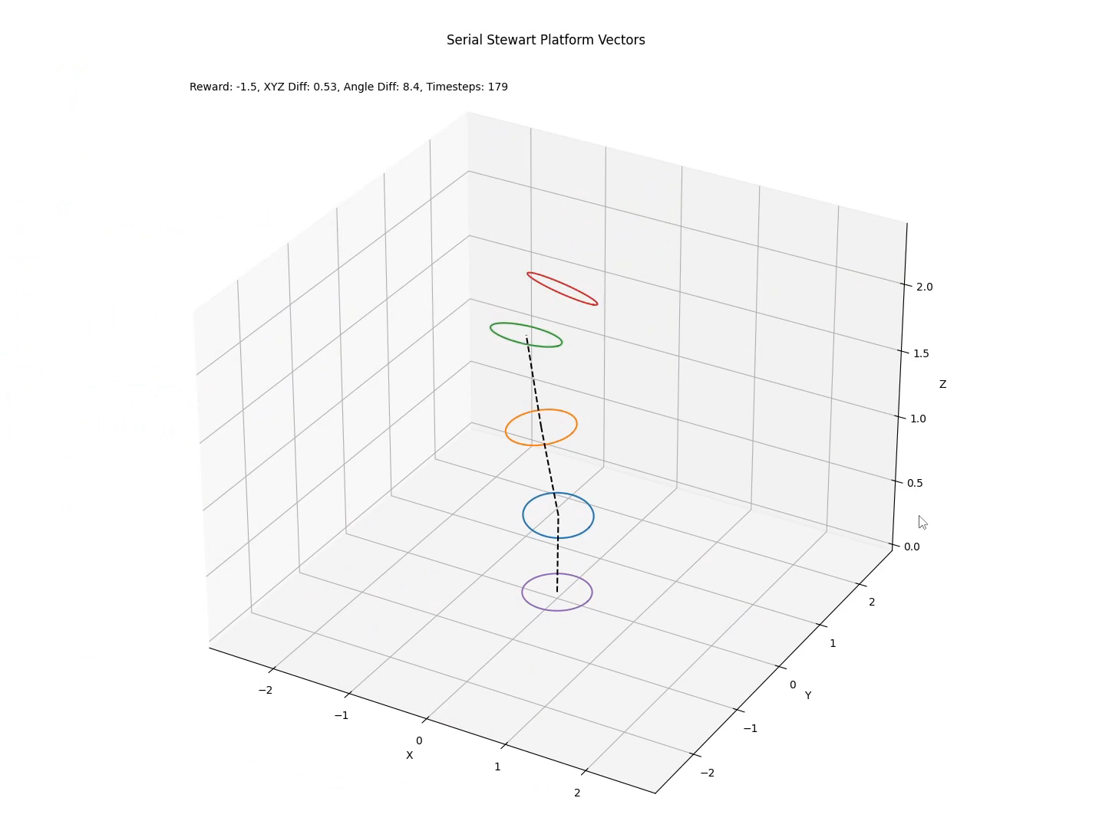
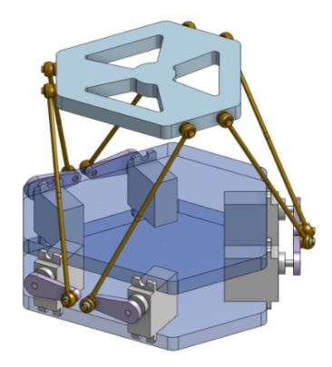
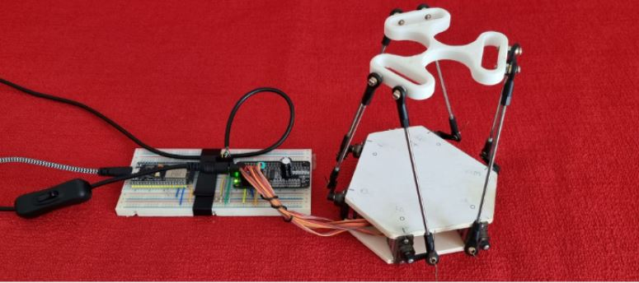
Previous Works
CSC 580: Artificial Intelligence, designed deep RL agent to control a stacked hexapod platform
Nicolas Jeanmonod, engineer, designed open-source hexapod controller for ESP32 microcontrollers
Thesis builds off Nicolas’ work, modifies it to work with four stacked platforms

Slide 12
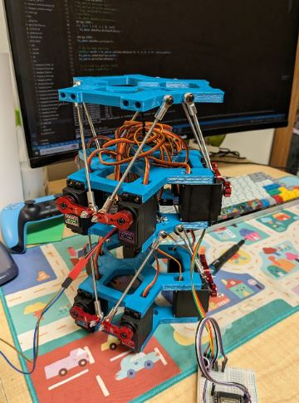
Design Overview
Four identical stacked hexapod platforms
Reduces complexity and cost
Independent control for each platform
Current version: identical control
3D-printed and off-the-shelf components
Purchased from Amazon and Ace Hardware
Total cost: $292
Name: Four-Stacked Hexapod Isometric Platform
Fo-SHIP (pronounced “faux ship”)

Slide 13
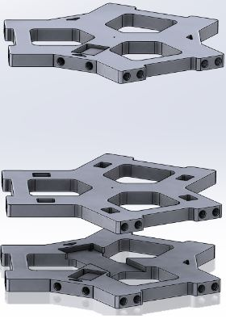
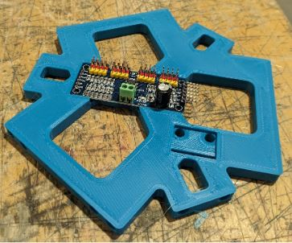
Mechanical Design
Designed five unique 3D-printed plates
Re-use simplifies manufacturing process
Heat-set inserts allow threaded connections
Electrical components have mounting slots
Base plate mounts to wooden base for stability
End effector plate has mounting holes for attaching array

Slide 14
Electrical Design
Multiple components need to interact and communicate
Microcontroller (ESP32) controls motors, makes decisions
Servo motors connected to PCA9685 motor driver
IMUs (angle sensors) detect orientation of each platform
DC power supply gives steady, high-amp electrical power
Different communications protocols between devices
ESP32 talks to motor drivers, IMUs over I²C
ESP32 talks to laptop, STM32 over serial (UART)

Slide 15
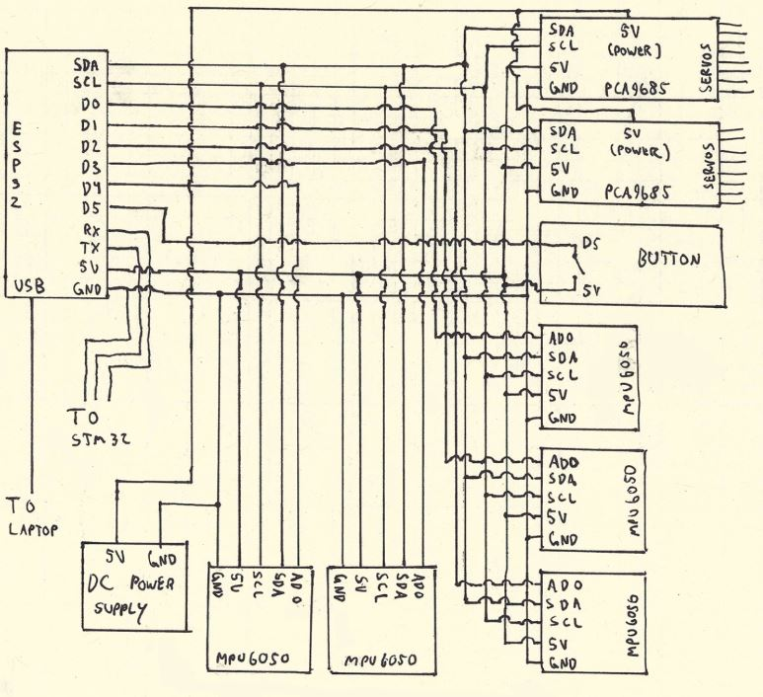
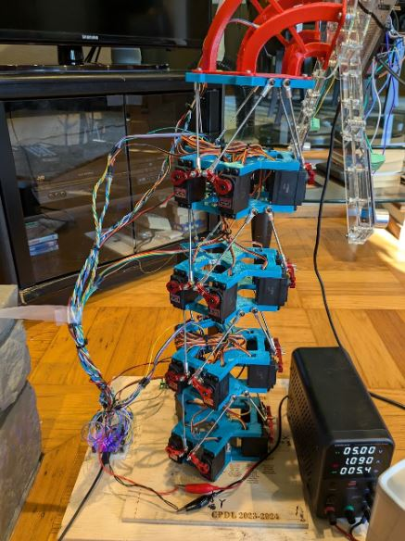
Wiring Diagram

Slide 16
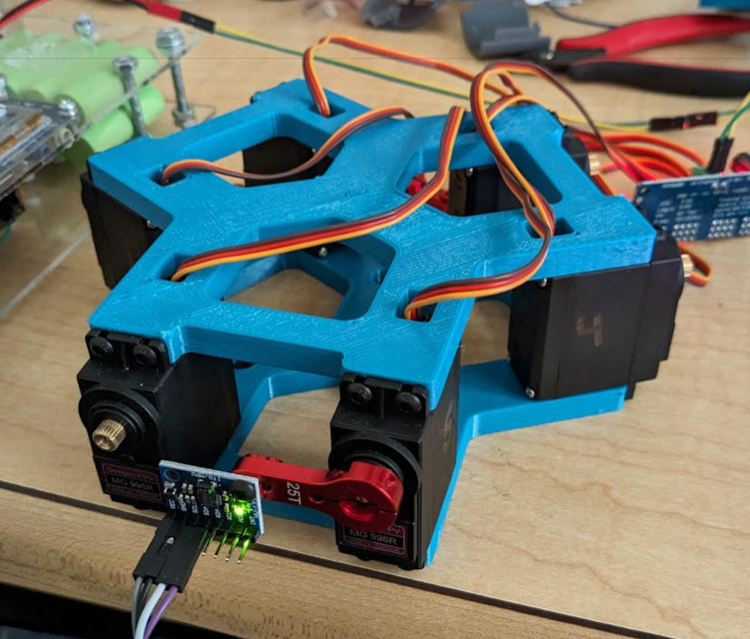
Manufacturing and Assembly
Plates 3D-printed in Mustang ‘60 Machine Shop
Wooden base fabricated in Mustang ‘60
Fo-SHIP assembled in stages
Electrical boards attached to base plates, heat-set inserts installed with soldering iron
Servo motors sandwiched between plates
Servo arms, threaded rods attached to servo output, then connected to next platform with ball joints
Platforms assembled from base to top, wires secured with cable ties after assembly

Slide 17
Software Overview
Written in C++ for ESP32 microcontrollers (MCUs)
Main tasks and functions:
Calculate servo angles for a desired position
Move each platform to that position
Determine XYZ position of end effector
Communicate w/ acoustic positioning system MCU (STM32)
Send data to laptop for future processing / storage
Demonstration functions:
Full range-of-motion, active tracking of transmitter

Slide 18
Single-Platform Inverse Kinematics
Given a desired top plate position, what should servos set to?
Solution w/ linear actuators is simple
Move top plate to desired position
Determine coordinates of P
Set each actuator length to BP
With rotary actuators, more complex
Define triangle ΔBAP
BA must be length of servo arm
AP must be length of threaded rod
Use trig identities, quadratic formula
P
__
__
__
B
A

Slide 19
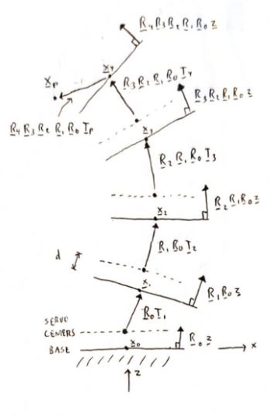
Multi-Platform Forward Kinematics
Orientation of each platform affects the one above it
Position of each platform given in local frame
Can be converted to global (“test”) frame
Describe each platform with two vectors
Translation – how does top plate shift in XYZ?
Rotation – what is normal vector to top plate?
Assume base of Fo-SHIP is on XY plane
Rotate each translation vector by orientation of platform beneath it, stack end-to-end

Slide 20
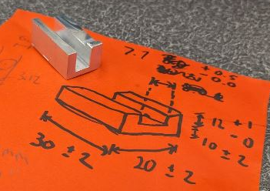
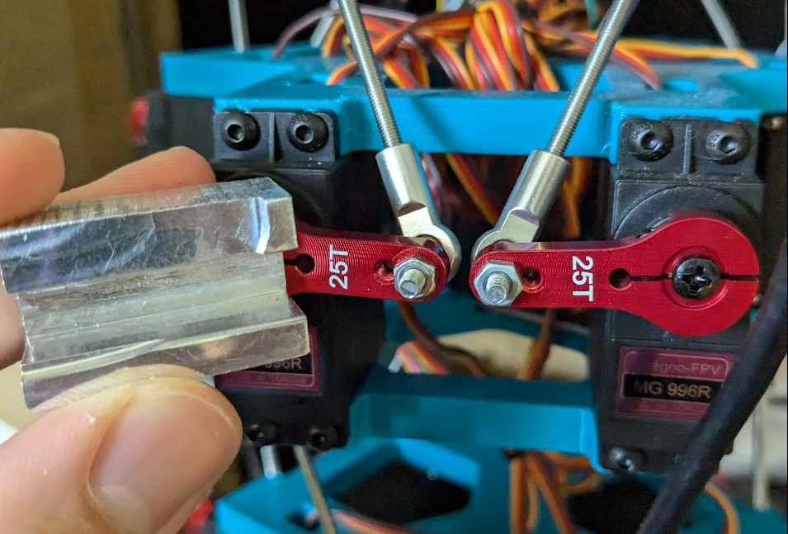
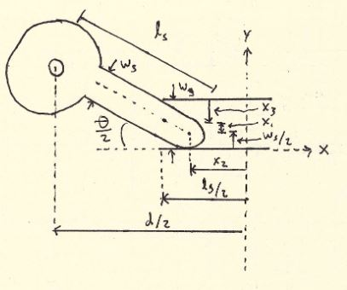
Servo Offset Calibration
Each servo motor has slightly different “zero” angle
Servo horns must be level for accurate positioning!
Manufactured go/no-go gauge in machine shop
Servo angle offsets adjusted in software until level
Max. angular misalignment of 3.7° between adjacent servos

Slide 21
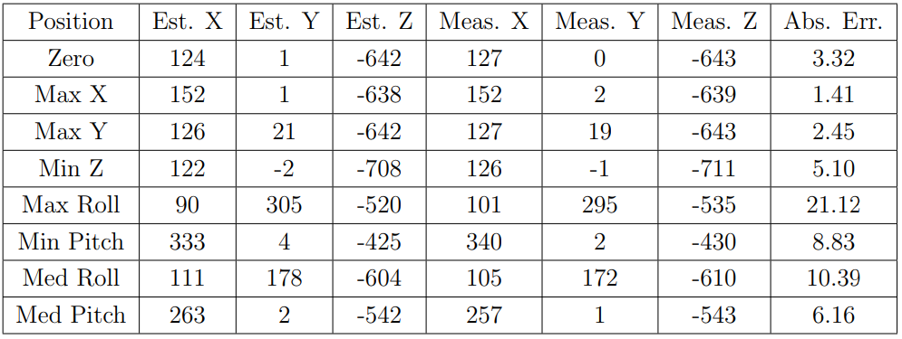
System Validation
Need to validate position estimate of Fo-SHIP end effector
Tested min/max of each axis, measured true position
Many potential sources of error:
Servo angular misalignments, incorrect platform dimensions
“Slop” in system compounds with each platform
Lower accuracy for larger angles/moves
Avg. error: 7.4mm Max. error: 21.1mm

Slide 22
Fo-SHIP Motion Demonstration

Slide 23
Acoustic Positioning System

Slide 24
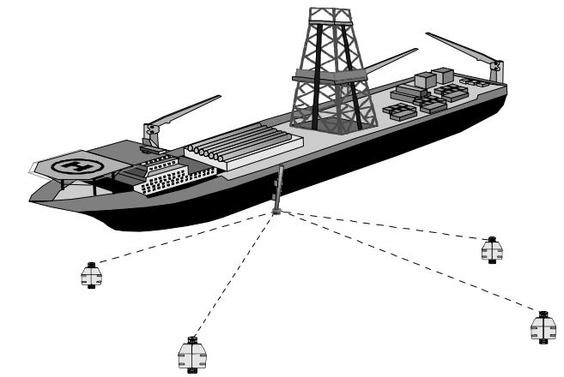
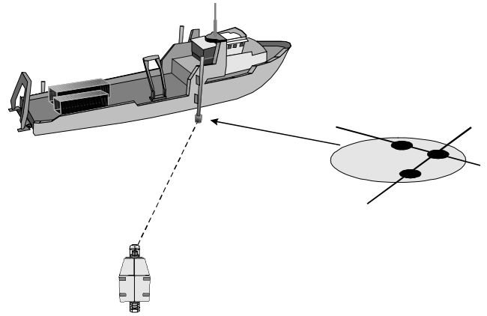
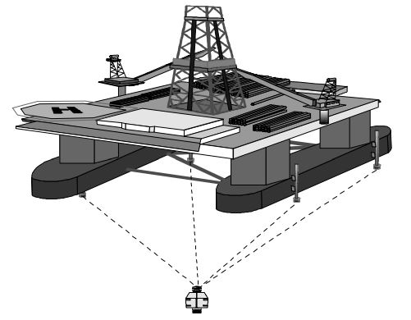
Long, Short, and Ultrashort Baselines
Main distinction in acoustic positioning systems is baseline
Baseline: spacing between receiver elements
Long baseline (LBL) uses spacing of >100m, fixed receivers
Ultrashort baseline (USBL) is <10cm, less than one wavelength
Short baseline (SBL) is in-between, mics usually on ship hull

Slide 25
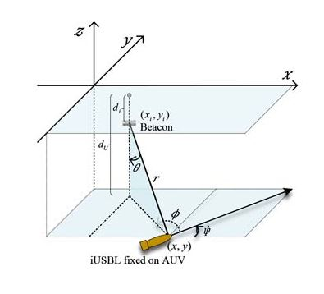
Inverted Short Baseline
USBL and SBL systems have receivers at surface of water
Inverted USBL (iUSBL) systems put receiver module on AUV
Single receiver module / housing
Inverted SBL (iSBL) would put receivers on body of AUV
Spacing can be > one wavelength
Receivers can be anywhere on body, not constrained to single module
Greater spacing = better accuracy
Similar implementations exist, but none called iSBL (except this one!)

Slide 26
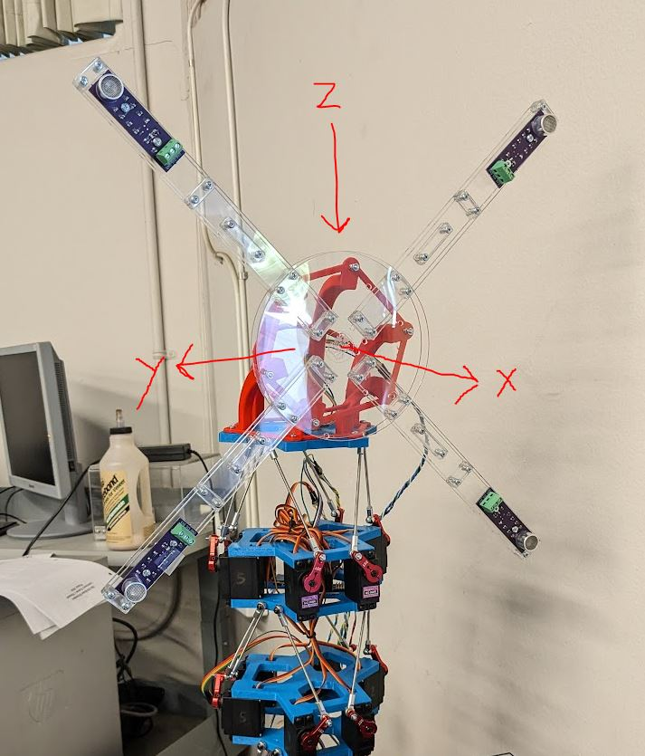
Receiver Array Mechanical Design
Array mimics body of AUV
Receivers spaced 25cm apart
Array made from laser-cut acrylic for lightweighting and lowering cost
3D-printed 90° adapter for attaching to Fo-SHIP end effector
Microcontroller, IMU, and breadboard mount on face of array
Coordinate system is NED

Slide 27
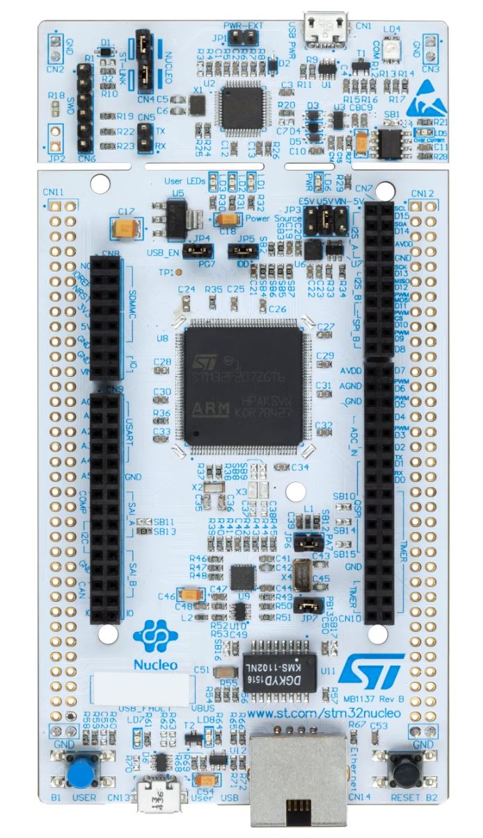
Receiver Array Electrical Design
STM32H723 high-performance microcontroller
Records at >1 million samples per second
Has >200kB of RAM for temporary data storage
High CPU clock speed of 550MHz
Communicates with Fo-SHIP ESP32 over UART
Reads from IMU over I²C
Connected to laptop with USB for debugging
Records from four microphones at 851.4kHz each
Smoothing capacitors for filtering electrical noise

Slide 28
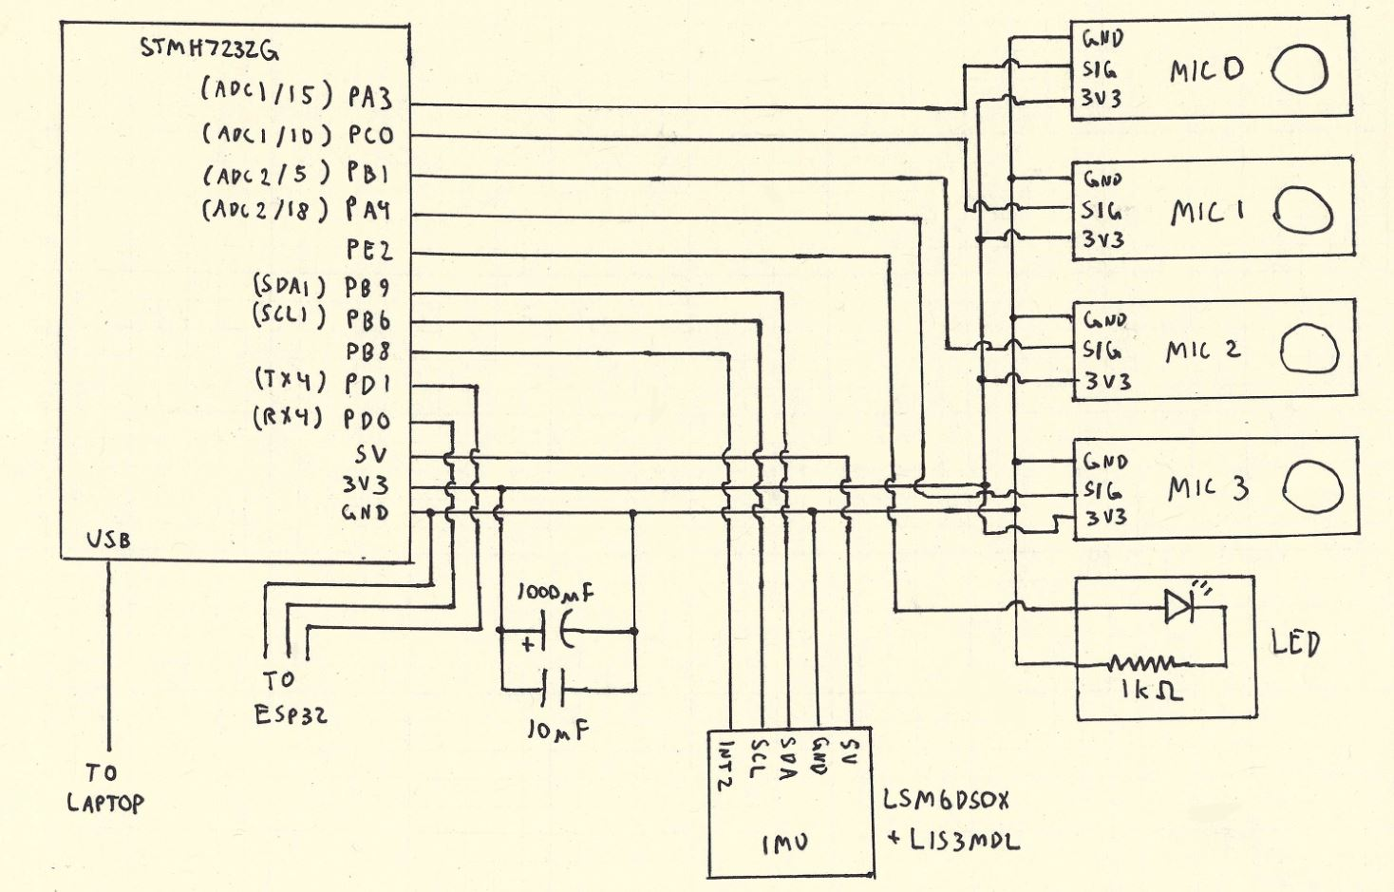
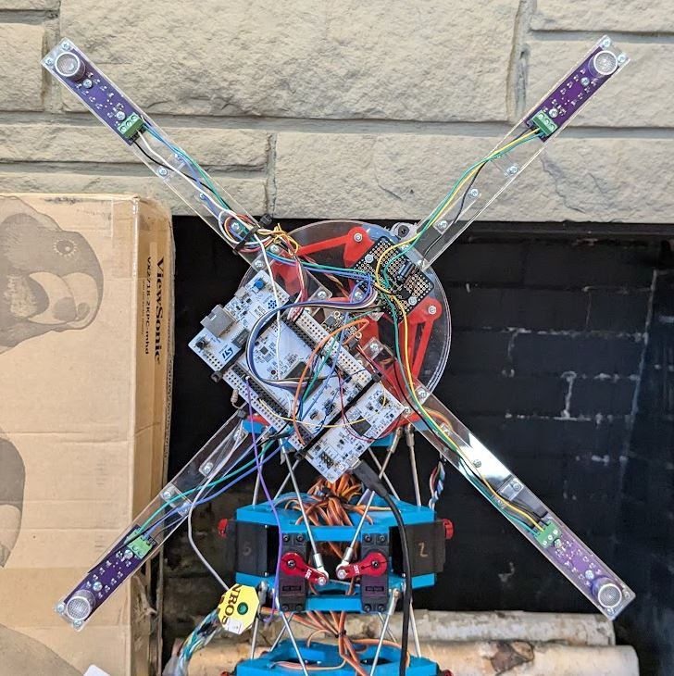
Receiver Array Wiring Diagram

Slide 29
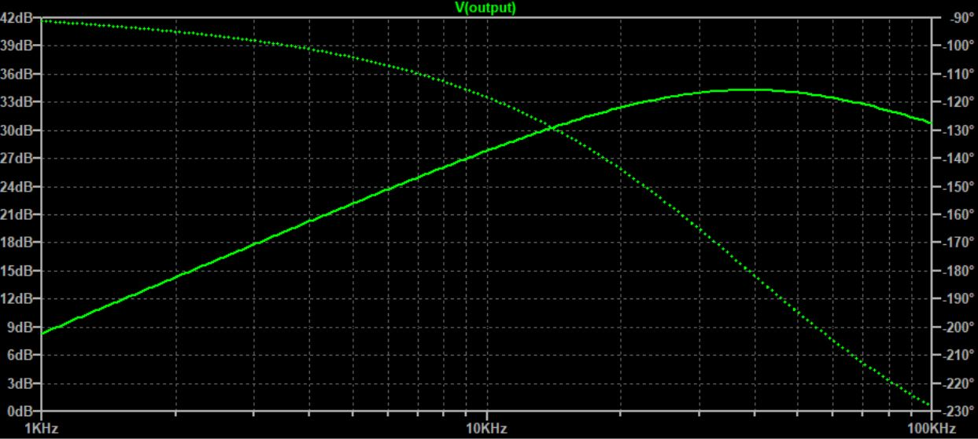
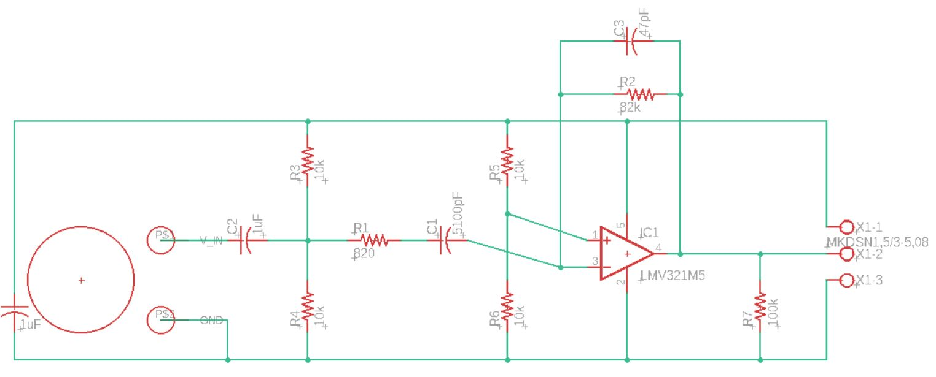
Active Band-Pass Filter Design
Raw ultrasonic receivers not sensitive enough, need boosting
Active band-pass filter provides amplification and filtering of non-40kHz signals (receiver operating frequency)
Adds 1.65V DC offset to use full range of ADCs
Provides gain of 34.5dB at operating frequency

Slide 30
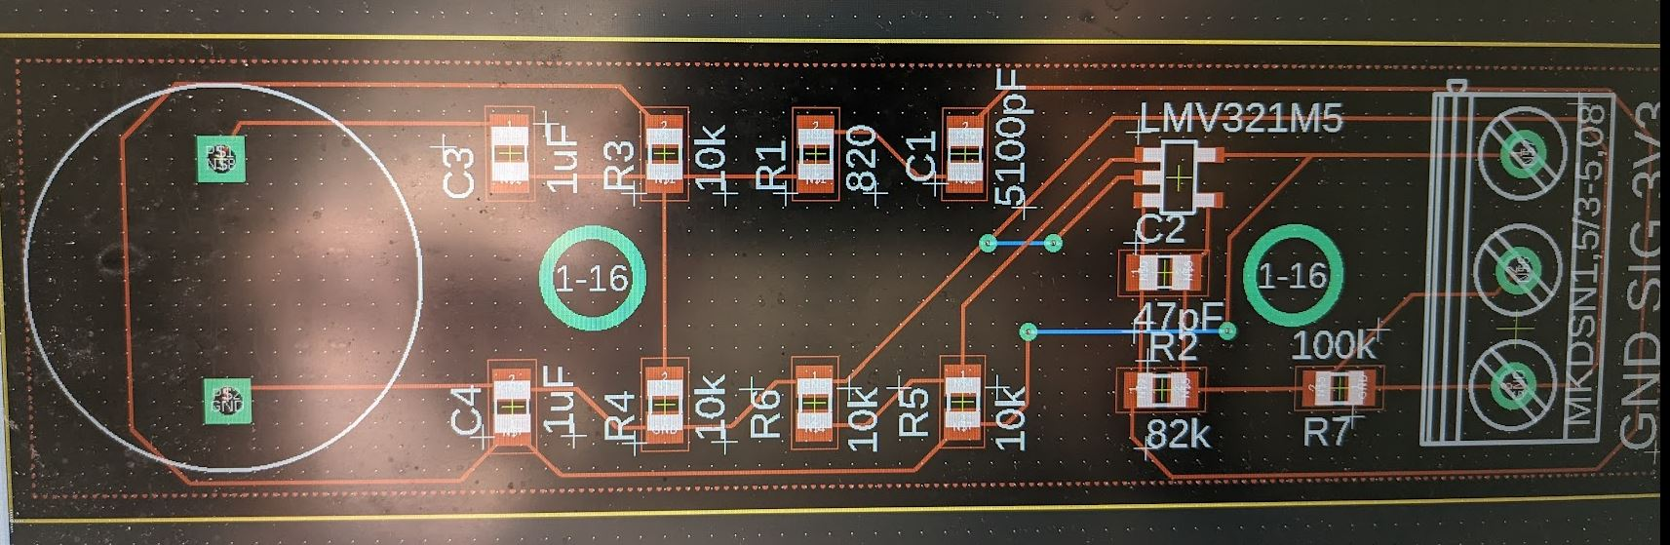
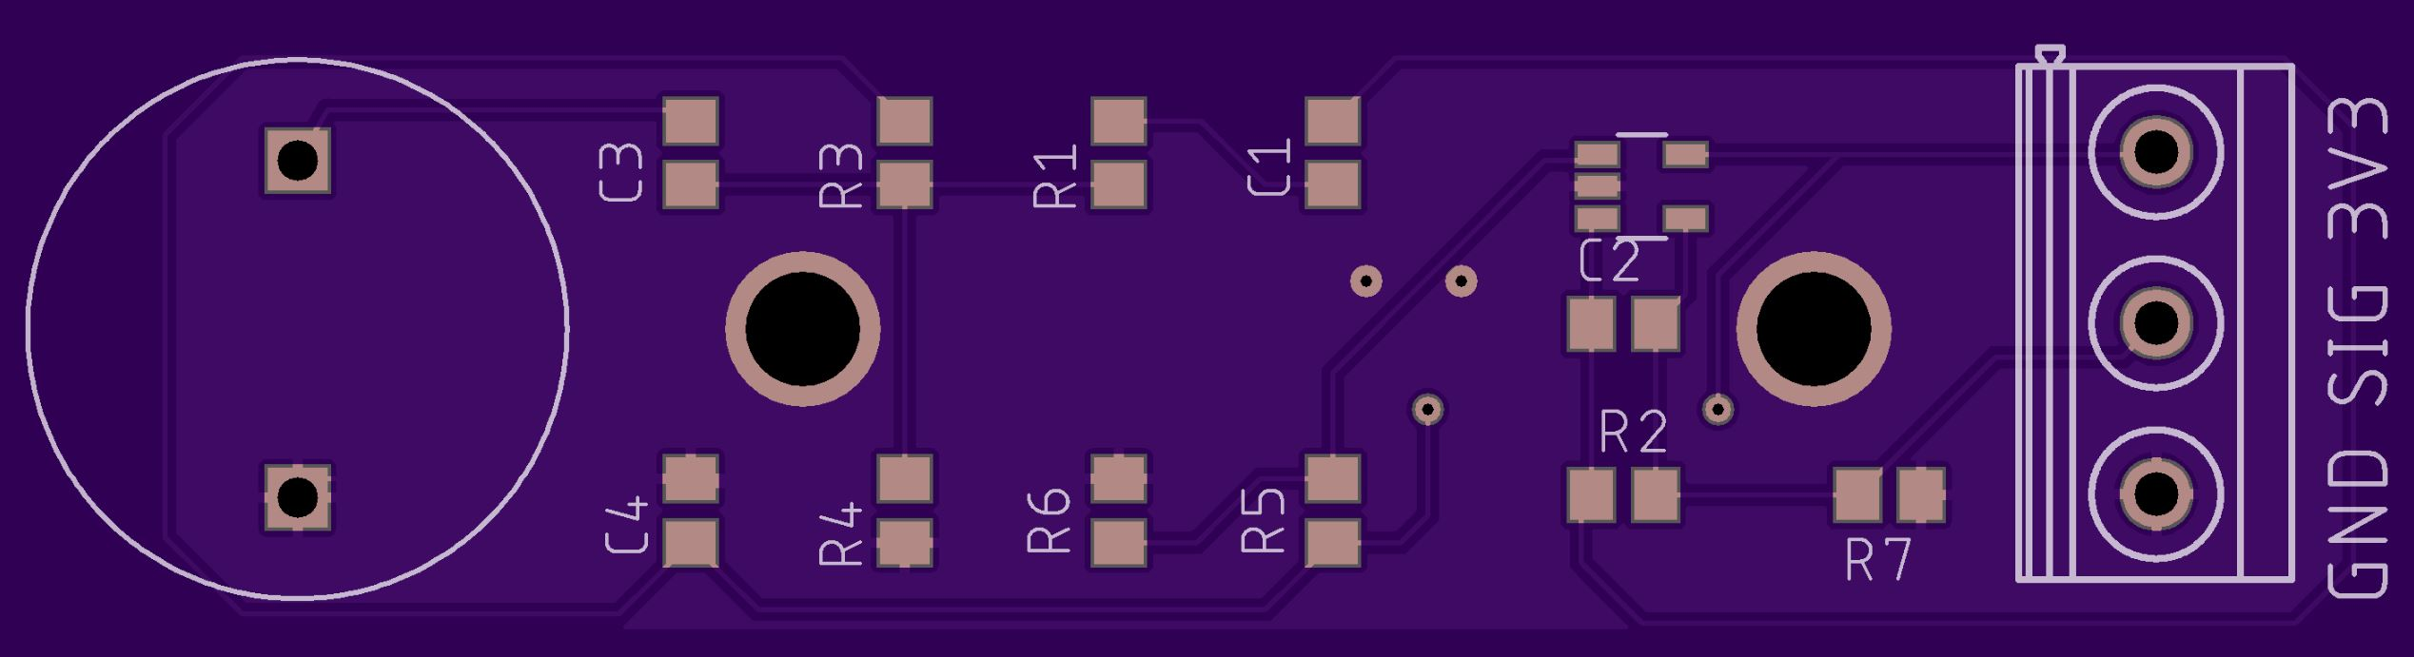
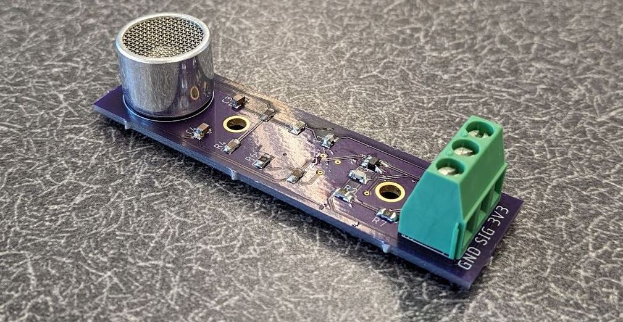
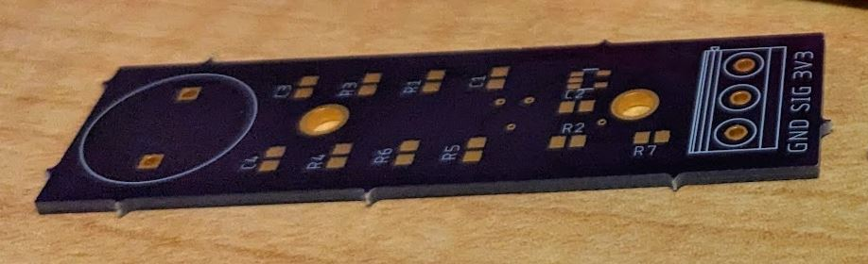
Active Band-Pass Filter PCB
Custom printed circuit board (PCB) designed in Eagle
Manufactured by OSH Park
Components ordered from Mouser Electronics
Uses common resistor and capacitor values to lower cost

Slide 31
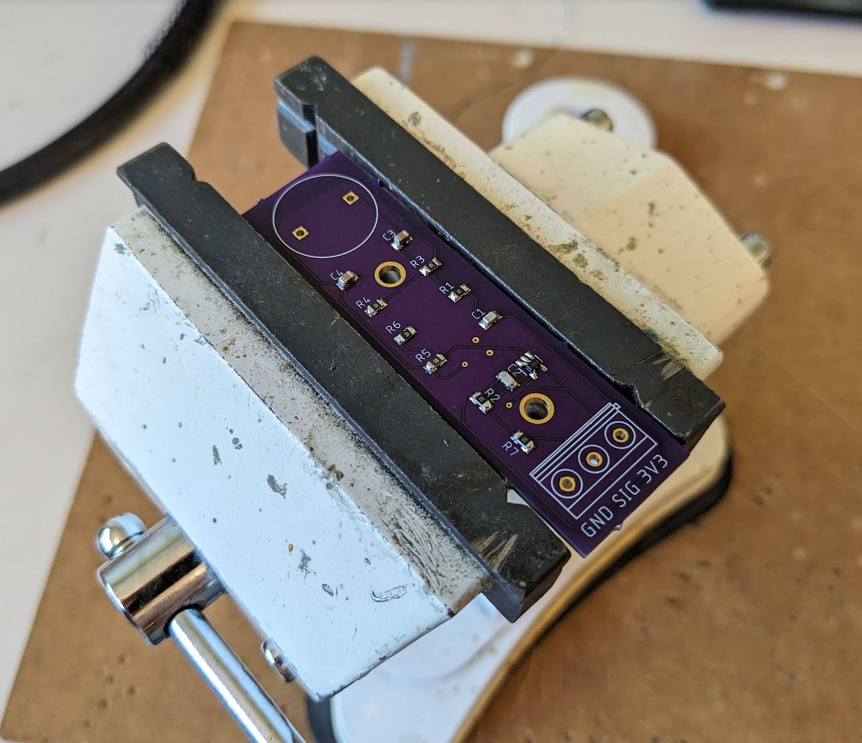
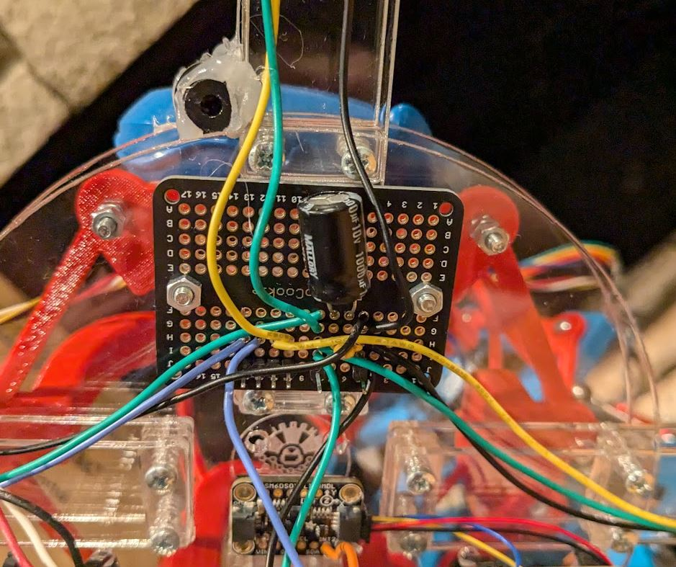
Receiver Array Assembly
Active band-pass filter PCBs soldered by hand
Soldered breadboard used to route power and mic signals
Wires cut to connect PCBs to breadboard and STM32
Array frame assembled with screws, attached to 90° adapter
STM32, IMU, and breadboard secured to face of array with screws and adhesive
Wires secured with cable ties

Slide 32
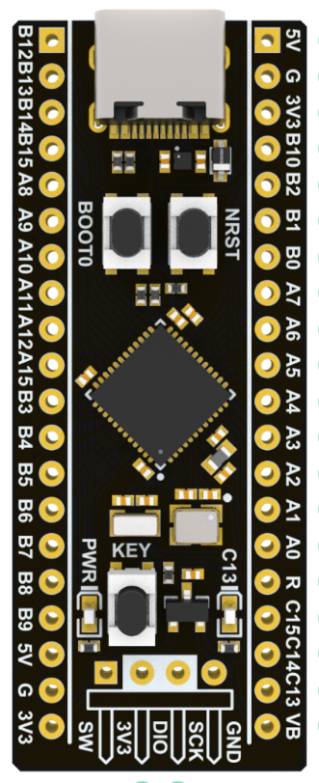
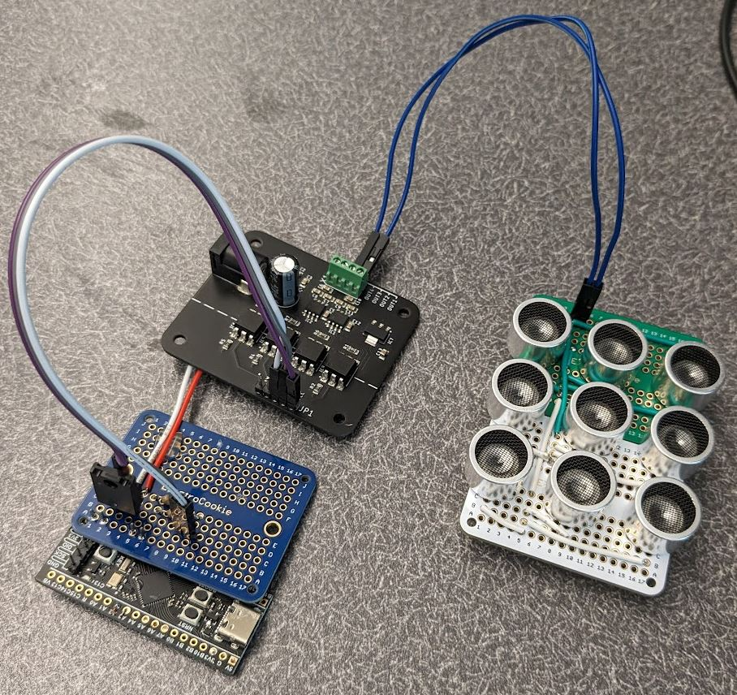
Transmitter Hardware Design
STM32F411, small form factor microcontroller
Only need two GPIO pins, one timer
Problem: how to drive 40kHz ultrasonic transmitter?
Multiple motor drivers tested, all failed
High update rate required (>80kHz), high voltage (12V)
Charlie donated optical-switching motor driver, successfully drives transmitter (thanks Charlie!)
Tested multi-element transmitter, cause phasing issues; single transmitter used for testing

Slide 33
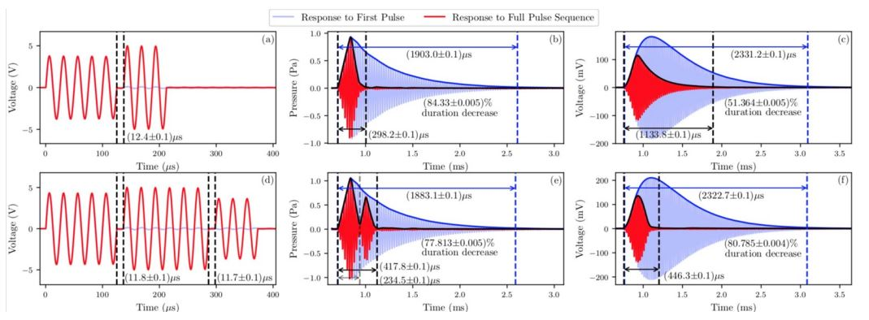
Engineered Ultrasonic Waves
Operating at receiver resonant frequency for best range
Problem: resonance increases sensitivity, but adds ringing!
Sending just one pulse (12.5us) rings for 2300us
Sharper pulse recordings = better time-differencing
UK researchers designed waveform to reduce ringing by 81%
Wave pattern: 5 in-phase 6 out-of-phase 3 in-phase

Slide 34
Transmitter Software Design
Implemented engineered waves into transmitter code
One “pulse” = one wave pattern (5-6-3)
Approximated pattern as square wave
Original goal was to transmit GPS coordinates over ultrasonic
Convert coords to character string: “x=20” -> “x”, “=“, “2”, “0”
Convert to ASCII 8-bit representation: “x” -> “01111000”
Send one pulse for 1s, wait (no pulse) for 0s
Currently sending random8-bit character using above system
Added 6-bit header to “trigger” recording on STM32
Sending pulses at 2000kHz, one per 0.5ms

Slide 35
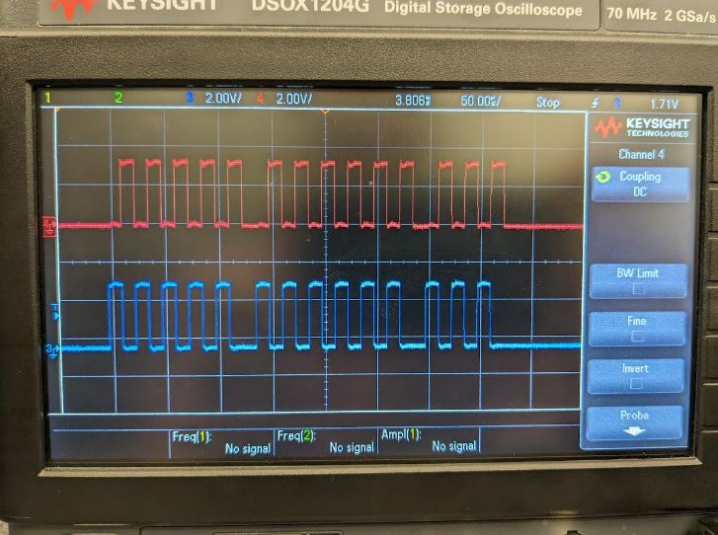
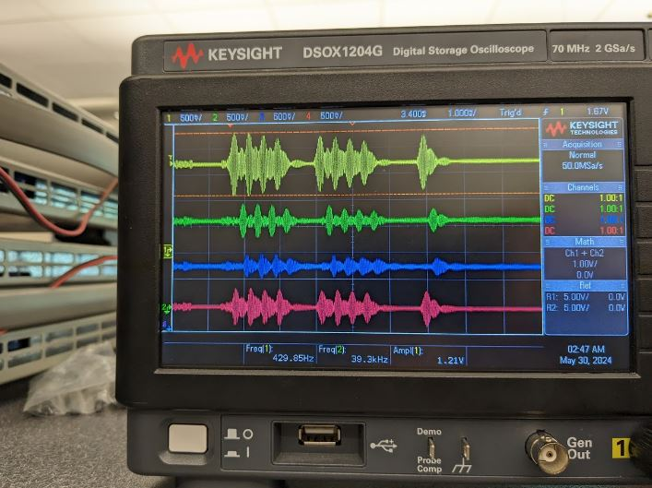
Transmitter Output

Slide 36
Finite-State Machine Representation
Acoustic positioning system program (running on STM32) has five main states
Initialization: starting timers, setting up algorithms, etc.
Triggering: checks for acoustic pulse every 0.1ms
Full Recording: once detected, records for 2.4ms
Recording Validation: checks if recording actually contains the acoustic pulse (a “good recording”)
Data Processing: converts a good recording to a new position estimate and sends data to Fo-SHIP ESP32

Slide 37
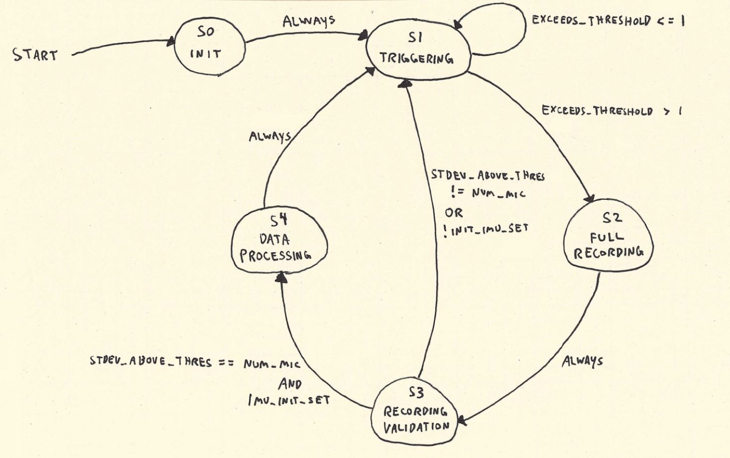
Finite-State Machine Diagram

Slide 38
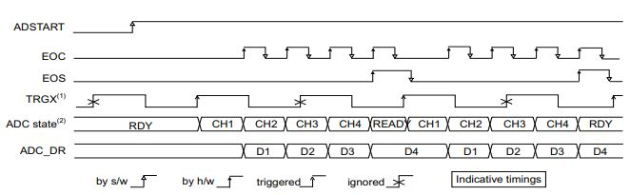
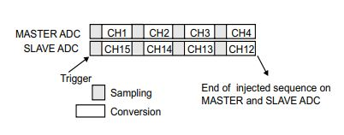
Analog-to-Digital Converter Setup
Analog-to-digital converters (ADCs) can measure voltages between 0 and 3.3V on STM32 GPIO pins
12-bit resolution (0.81mV) used, 0.42us per conversion
If sequential (Mic0 -> Mic1 -> …), max sampling rate is 595kHz
Using MultiMode (dual ADC), can double max sampling rate
Primary ADC triggers secondary, two conversions at once

Slide 39
Triggering State
After initialization, first step is to check for an incoming pulse
Active band-pass filter removes non-40kHz audio
Assume any large readings from the ADC -> pulse incoming
Record 64 samples from each mic, check if any five samples in a row exceed a threshold; if so, pulse detected
One 40kHz wave -> 21.3 samples, five samples is enough
More samples/mic -> longer trig time -> less recording time
64 is good middle-ground, takes 0.1ms to record and check
If any mic exceeds threshold, move to full recording state
Otherwise, repeat triggering process

Slide 40
Full Recording and Validation States
Full recording, 2048 samples per mic (2.4ms / 7ms full pulse)
IMU processing halted during full recording to prevent noise
Once saved, need to verify that recording contains pulse
Calculate standard deviation for each microphone signal
If std. dev. of all four mics > threshold, then recording is there
Threshold set just above ambient noise level
Area for improvement: use average of std. dev’s to determine how much to trust an acoustic measurement?

Slide 41
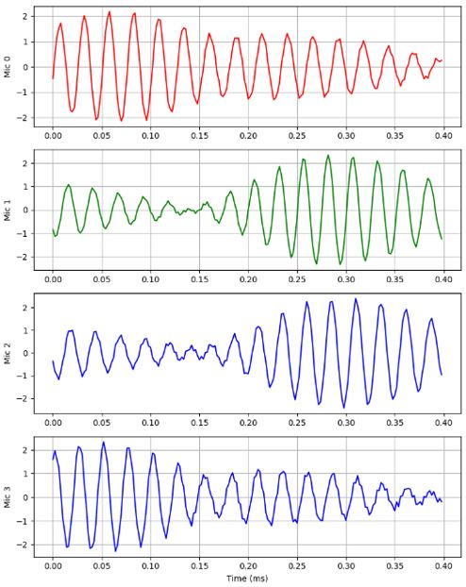
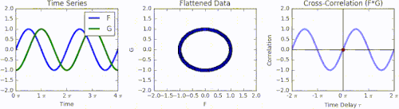
Determining Time Shifts
Problem: need to find time shift between four mic signals
Assume signals are identical in shape, but time-shifted
Compare only two signals at a time
Solution: use cross-correlation!
Shifts signals over each other, peak of output shows time shift

Slide 42
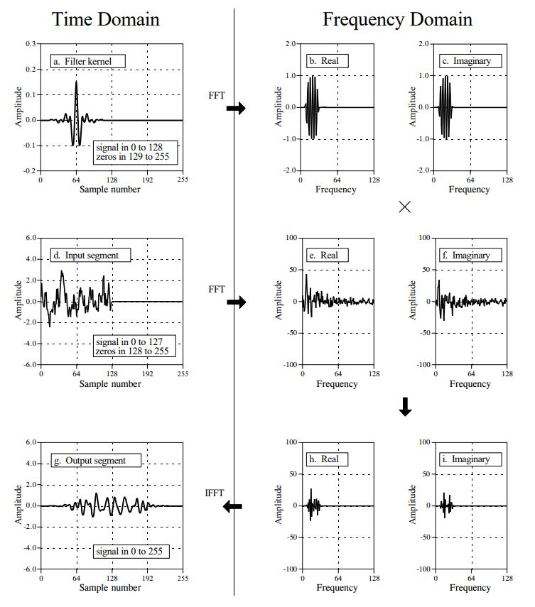
FFT Cross-Correlation Theory
Problem: cross-correlation is very slow
Solution: use fast Fourier transforms to speed up computation
Cross-correlation ≈ convolution
Convolution in time domain -> multiplication in frequency domain
Convert signals to freq. domain using FFT, multiply signals, then convert back to time domain with inverse FFT
Output is equivalent to normal method, but takes 99.9% less time (n_{samples}=4096)

Slide 43
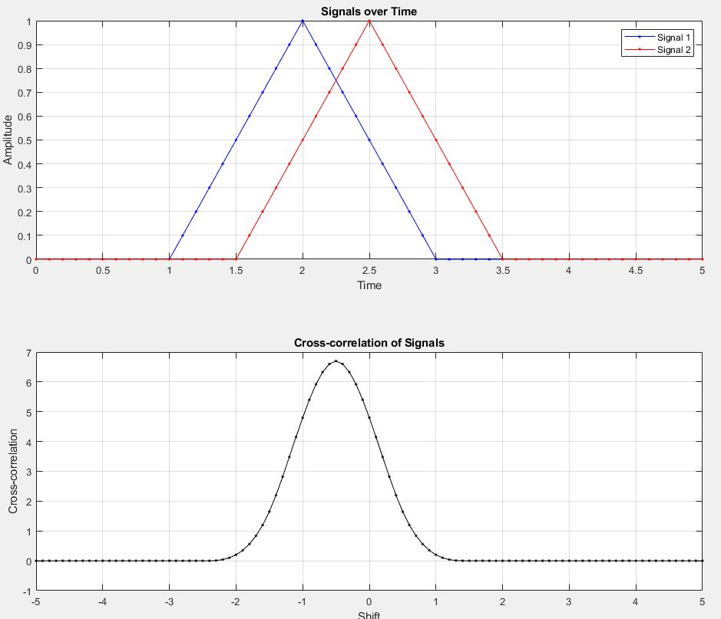
FFT Cross-Correlation Code
FFT cross-correlation implemented in C using arm_math.h
Three comparisons: mic0 vs mic1, mic0 vs mic2, mic0 vs mic3
Only three unique pairs; choice of mic0 is arbitrary
For each pair:
“Flip” second signal
Take FFT of both signals
Multiply results of FFTs
Take inverse FFT of product
Find maximum of output
Convert index from sample# to time

Slide 44

Rotating the Receiver Array
Before converting time shifts to position, need to account for orientation of receiver array relative to test frame
Current orientation is known (Madgwick filter in background)
Create 3D coordinates for each microphone based on config
Rotate each point by current orientation of array
Now, position of each microphone is known in test (global) frame!

Slide 45
Residual Function
Position of each mic, and time shift between mics, is known
How to find transmitter position based on this?
Define a residual function r(tx_guess, mic_coords, time_shifts)
tx_guess: guess for transmitter coords in 3D (in test frame)
Calculate distance from tx_guess to each microphone
Convert to time-of-arrival (TOA) using speed of sound in air
Subtract TOAs between mics to get estimated time shifts
Find difference between estimated and measured time shifts
If tx_guess is at true transmitter position -> residual is zero!
If tx_guess is very far from true position -> larger residual

Slide 46

Hooke-Jeeves Search Algorithm
Most likely transmitter position is minimum of residual function
Problem: need a way to find the minimum of 3D function
Solution: Hooke-Jeeves search algorithm!
Start with some initial position estimate
Test points s distance away in each dir.
Move in direction of lowest residual, with step size s, until residual begins to grow
Cut step size in half and test new dir’s
Halt when exit condition is met
Always converges, is very accurate for this residual function

Slide 47

Incorporating Transmitter Position
Hooke-Jeeves search returns position of transmitter relative to center of receiver array
Position of transmitter already known (GPS buoy)
Want to know position estimate of receiver array!
Receiver position = transmitter position – relative position
Finally, single estimate for center of receiver array using only acoustic measurements!
Position estimate in test frame
Can compare to true position (Fo-SHIP)

Slide 48
Single-Pass Overview
Transmitter sends an acoustic pulse towards receiver array
ADCs trigger, pulse is recorded on four mics and verified
Time shift between signals found using FFT cross-correlation
Position of each microphone rotated using current orientation
Hooke-Jeeves search finds minimum of residual function
Returns position of transmitter relative to center of array
Use known transmitter location to get position estimate of center of receiver array in test frame

Slide 49
Absolute Orientation and Dead Reckoning

Slide 50
Measuring Orientation
Transmitter

Slide 51
MEMS IMUs
Transmitter

Slide 52
IMU Calibration
Transmitter

Slide 53
Sensor Fusion Algorithms
Transmitter

Slide 54
Madgwick Filter Overview
Transmitter

Slide 55
Madgwick Filter Theory
Transmitter

Slide 56
Madgwick Filter Implementation
Transmitter

Slide 57
Madgwick Filter Tuning
Transmitter

Slide 58
Dead Reckoning Overview
Transmitter

Slide 59
Velocity Drift Compensation
Transmitter

Slide 60
Dead Reckoning Implementation
Transmitter

Slide 61
Dead Reckoning Validation
Transmitter

Slide 62
Live Data Collection Demonstration

Slide 63
Kalman Filtering

Slide 64
Kalman Filter Introduction
Transmitter

Slide 65
Airplane Example
Transmitter

Slide 66
Kalman Filter Overview
Transmitter

Slide 67
Initialization Step Theory
Transmitter

Slide 68
Prediction Step Theory
Transmitter

Slide 69
Update Step Theory
Transmitter

Slide 70
Software Implementation
Transmitter

Slide 71
iSBL Kalman Filter Design
Transmitter

Slide 72
iSBL-SF Kalman Filter Design
Transmitter

Slide 73
Kalman Filter Tuning
Transmitter

Slide 74
Data Collection and Results

Slide 75
Testing Plan
Transmitter

Slide 76
Test Environment
Transmitter

Slide 77
Data Collection Summary
Transmitter

Slide 78
Stationary vs Moving Accuracy
Transmitter

Slide 79
Gradual vs Rapid Movement Accuracy
Transmitter

Slide 80
Effect of Distance on Accuracy
Transmitter

Slide 81
Effect of Angle on Accuracy
Transmitter

Slide 82
Evaluating Normality
Transmitter

Slide 83
Overall Accuracy
Transmitter

Slide 84
Active Tracking Demonstration

Slide 85
Conclusion and Future Work

Slide 86
System Overview and Recap
Transmitter

Slide 87
Extrapolation to Underwater Regime
Transmitter

Slide 88
Recommendations for Future Work
Transmitter

Slide 89
Accomplishments
Transmitter

Slide 90
Questions

